Slide 1

《庄子说》漫画多模态英译研究
A STUDY ON THE TRANSLATION OF THE COMIC BOOK ZHUANGZI SPEAKS FROM A MULTIMODAL PERSPECTIVE
答辩人：徐雨翔

Slide 2



目录
Multimodal Analysis of Zhuangzi Speaks and
Its Translation
CONTENTS
Conclusions
Literature Review
Comic Translation Strategy and Methods Based
on Multimodal Analysis
Theoretical Framework
Introduction

Slide 3
1.1 Research Rationale
Part1
Introduction
1.2 Research Significance
1.3 Research Objective and Questions
1.4 Methodology and Research Material

Slide 4
1.1 Research Rationale
Comics are a pervasive art form and an intrinsic part of the cultural fabric of most countries. (Zanettin, 2015: 3)
However, perhaps because of its image-based nature, comics are often treated as less worthy of academic research. This is quite true in translation studies as well.
Besides, among the limited number of works dedicated to comic translation, most of them restrict themselves to the analysis of verbal text which is only part of the equation.
With the rapid growth of mass media, it is crucial to realize the verbal mode is just one of a variety of semiotic systems. Thus, this thesis intends to apply a multimodal approach to comic translation, exploring the roles of both images and text, based on a case study of Zhuangzi Speaks.

Slide 5
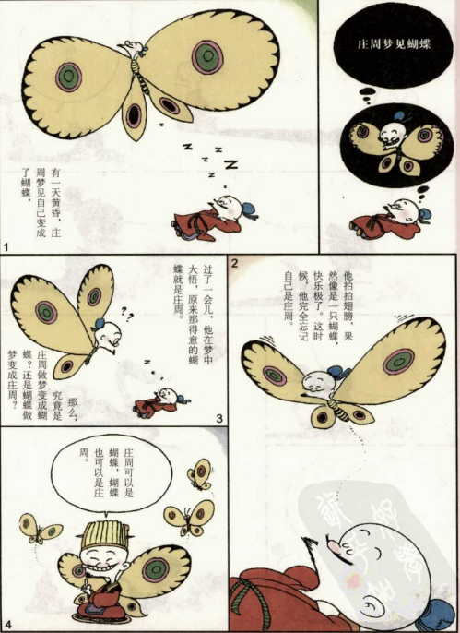
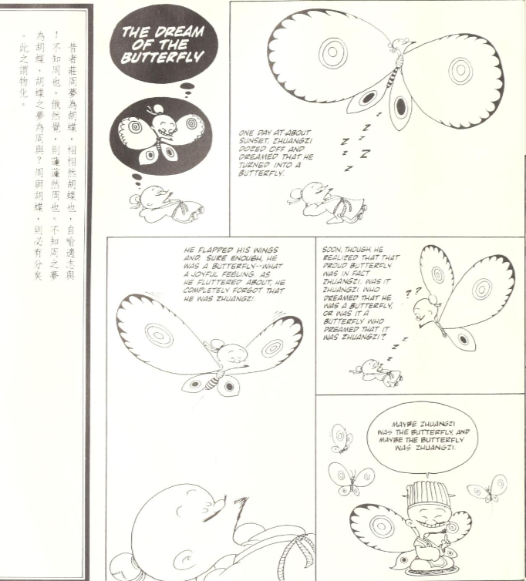
A Synopsis of Zhuangzi Speaks
Zhuangzi Speaks, a comic book compiled and illustrated by Taiwanese cartoonist Tsai Chih Chung, draws its content primarily from the Chinese classic Zhuangzi. Through humorous images and simplified texts, the book conveniently explicates the philosophy of Daoism in a vivid and reader-friendly fashion.
The English translation was done by American philosopher B. Bruya and has garnered widespread acclaim from Western readers, with an Amazon rating of 4.6 out of 5.0.The resounding success of its translation has already drawn academic interest.

Slide 6
1.2 Research Significance
Theoretical value
Expand the application of multimodal discourse analysis and add to the findings of image-text relations in the course of comic translation.
Significance
Practical Value
Identify and summarize strategies and methods for Chinese-English comic translation drawn from multimodal analysis and does its part in helping more Chinese comics go global.

Slide 7
1.3 Research Objective and Questions
Objective
Analyze the changes in images between the original and the translation with visual grammar by Van Leeuwen.
Examine the visual-to-verbal relations in comic translation based on Martinec Salway’s image-text relations framework.
Derive effective translation strategies and methods from the preceding multimodal analysis
Questions
Have the original images been altered in the translation? If so, does it help justify the huge popularity of the comic?
In most cases, have the image-text relations in the original shifted in the translation?
What kind of translation strategies and methods can be drawn based on multimodal analysis?

Slide 8
1.4 Methodology and Research Materials
Methodology
Visual Analysis
Multimodal Discourse Analysis
Inductive Reasoning
Materials
The latest colored Chinese version of Zhuangzi Speaks printed in 2019
Its first and only monochrome English translation by Bruya, published in 1992.

Slide 9
2.1 Previous Studies on Multimodality
Part2
2.2 Previous Studies on Comic Translation
Literature Review

Slide 10

2.1 Previous Studies on Multimodality
2.1.1 Previous Studies on the Application of Multimodal Discourse Analysis
O’Toole was the first to have applied SFG to explore art images in his work The Language of Displayed Art (O’Toole, 1994) where he proposed three metafunctions: representational, modal and compositional exist in multimodal discourse like paintings and concluded the artistic discourse can be conceived as a systemic whole with a hierarchy of units for detailed multimodal analysis
Kress & Van Leeuven in their book Reading Images: Grammar of Visual Design (Kress & Van Leeuven, 1996) took up O’Toole’s idea and theorized images boasted three types of meaning-making resources: representational, interpersonal, and compositional. They also devised a framework to seek out the meaning of visual composition, affirming the validity of MDA.
O’Halloran utilized MDA to investigate the integration of images, mathematical symbolism, and symbolic resources in mathematic texts (O’Halloran, 2005).
Baldry and Thibault (2006) provided concrete solutions for issues in multimodal discourse and transcription across various media formats such as printed texts, films, and advertisements
Li (2003), Hu (2007), Zhu (2007) were among the first Chinese scholars to have introduced the concept of MDA, underscoring the significance of non-verbal semiosis. Zhang (2009) employed MDA to study the choice of efficient procedures in foreign language teaching with modern media technology. Sun (2012) utilized visual grammar to describe the emblem of the Xi’an Expo. Wang (2020) pointed out the trend of the integration of critical discourse analysis and multimodal discourse

Slide 11
2.1.2 Previous Studies on Image-Text Relations
Barthes (1977a,1977b) asserted the relationship between images and text is built upon a simple logic of three potential ways in which they can interact: anchorage (where text supports image), illustration (where image supports text), relay (where the status of two modes is equal).
Kress & Van Leeuven (1996) also admitted there is an intimate relationship between verbal and visual modes, adding what can be expressed in speech or writing through words may well be visually represented using different compositional structures, though they believed images should be seen as being independent of text.
Martinec and Salway (2005) have extended Halliday's analysis of clause relations within sentences to explore status and logico-semantic relations between language and image. Royce (1998, 2007) examined the intersemiotic relations between images and text within an advertisement and an article accompanied by caricatures. He found that text and images can ‘complement each other at the semantic level and jointly construct a unified and coherent text’ (Royce,2007:70).
In China, Zhou (2005) was the first to have suggested that the dynamics between images and text had evolved, suggesting a break with the text-central mindset.
Wang and Zeng (2010) conducted an analysis of how verbal and visual symbols interact to convey meaning in comics, probing the implications of inter-semiotic theory for understanding multiple literacies and systemic functional teaching methodologies.

Slide 12
2.2 Previous Studies on Comic Translation
2.2.1 Multimodal Approaches to Comic Translation
Kaindl (1999) first contended ‘neither a linguistic nor a purely textual approach is sufficient to deal comprehensively with these changes’ (in comic translation) (1999: 265). He recognized the significance of non-linguistic elements in comics and its necessary modifications for different cultures and proposed translation procedures based on different image-text relations.
Kaindl (2004) began examining in earnest the role of multimodality during the translation of humor in comics, zeroing in on the interplay between the visual and the verbal as well as illustrating how humorous meanings are realized across the two modes.
Celotti (2008) emphasized that comic strip translator should be able to recognize the interaction and autonomy between verbal and visual modes as well as strive to achieve coherence between words and pictures. Borodo (2015: 25) further argued the visual reinforce the textual, clear up confusion, and facilitate the process of translation through a case study of Polish comics.
Shang (2020) applied Zhang's (2013) theory of multimodal discourse analysis to analyze Chinese translation of the Marvel comics, pointing to the need for fully understanding the interaction between various modes. Chen (2021) examined the translation of the comic version of Huangdi Neijing. She discovered that the handling of visual information and the structure of text and images play a crucial role in the success of visual storytelling.

Slide 13
2.2.1 Translation Studies on Tsai’s Comics
Huang Guangzhe(2018) conducted a case study of the reception of the translation of Tsai Chih Chung’s Confucius Speaks in the U.S. Prioritizing the function of images, he suggested the translation of images should seek to enrich visual information, stimulating readers’ desire to identify with translated content.
Han Ziman(2023) analyzed the multimodal characteristics of Zhuangzi's portrayal in Tsai Chih-chung's Zhuangzi Speaks by introducing the concept of what he called ‘performative translation’. He found the multimodal information (i.e. gestures, color) in the translation allows readers to understand the characters' actions and emotions without needing a deep knowledge of the culture.
Most recently, Huang Guangzhe (2024) also took up Zhuangzi Speaks and placed its three translations of different languages under scrutiny through the lens of multimodality. He compared the construction of Zhuangzi’s image as a comic character on the front cover of the original and that in different translations.

Slide 14
Part3
3.1 Working Definitions
Theoretical Framework
3.2 Theoretical Basis
3.3 Analytical Framework

Slide 15
3.1 Working Definitions
Mode is a socially shaped and culturally given resource for making meaning. (Kress, 2009: 54). In other words, image, writing, speech, gesture, music and the like can all be counted as modes as they are able to represent and communicate meanings.
Multimodality was defined by Kress and Van Leeuwen as, ‘The use of several semiotic modes in the design of a semiotic product or event’ (2001: 20).
Semiotic resource generally refers to resources that are capable of meaning-making.
Multimodal Discourse: Here, ‘discourse’ refers to the communication or expression of meaning through different modes. There are two definitions of multimodal discourse:
The discourse is realized through two or more semiotic modes.
The discourse is realized through a single mode which contains two or more semiotic resources.

Slide 16
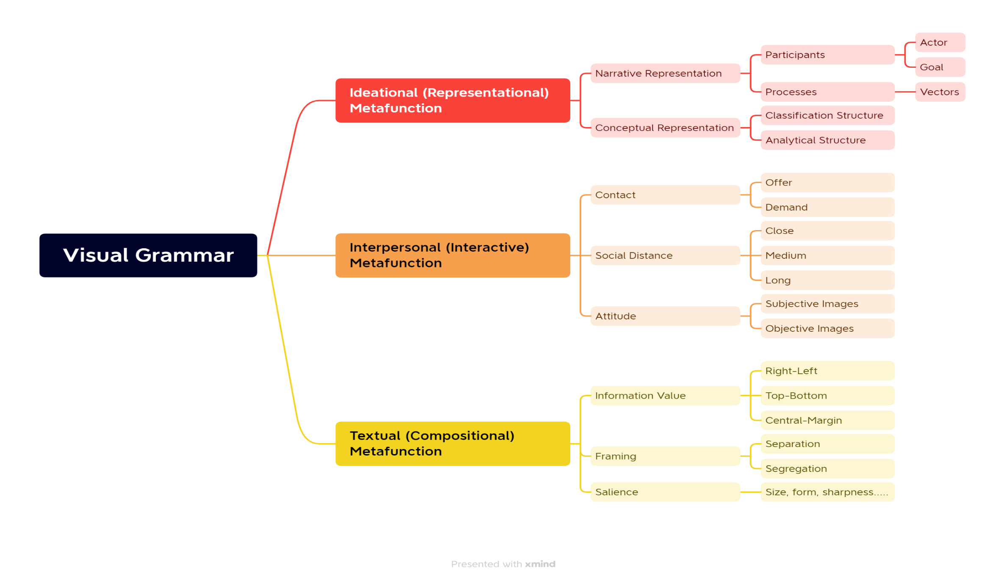
3.2 Theoretical Basis
a. Visual Grammar

Slide 17
b. Martinec and Salway’s Image-Text Relations Framework
Martinec and Salway’s framework draws mostly on systemic-functional linguistics. They follow Halliday’s description of the relations between clauses in a sentence and apply them to relations between text and images.
They adapt the notion of dependency to describing the logico-semantic relations in a multimodal text while also taking into account Barthes’ relay to present different status between language and images. Their system of image-text relations thus serves to specify how both status and logico-semantic relations between images and text are realized.
Logico-Semantic Relations
Elaboration
Exposition
Exemplification
Extension
Enhancement
Time
Place
Reason/Purpose
Image-Text Status
Equal
Independent
Complementary
Unequal
Image Subordination
Text Subordination

Slide 18
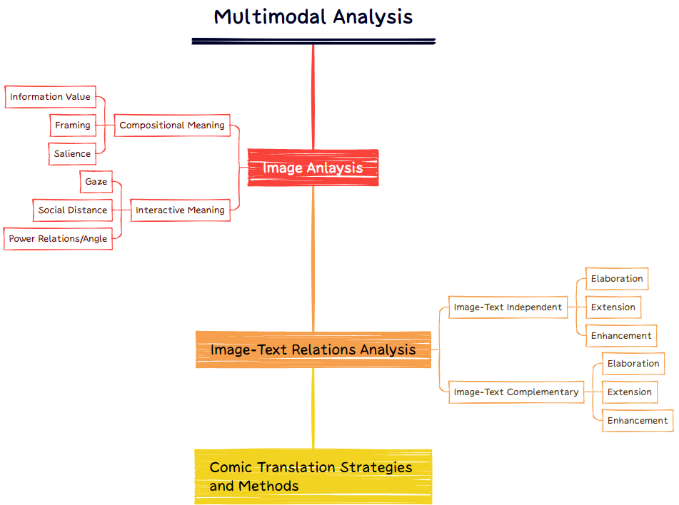
3.3 Analytical Framework

Slide 19
Part4
Multimodal Analysis of Zhuangzi Speaks and
Its Translation
4.1 Image Analysis
4.2 Image-Text Relations Analysis

Slide 20
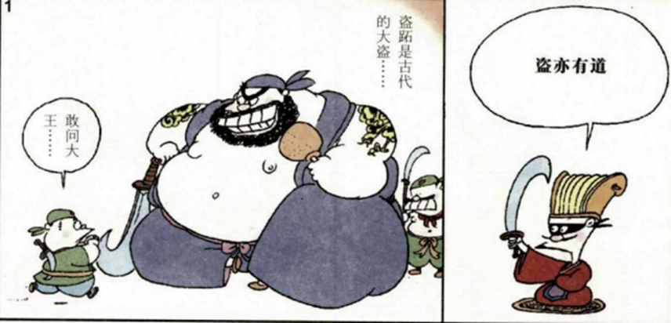
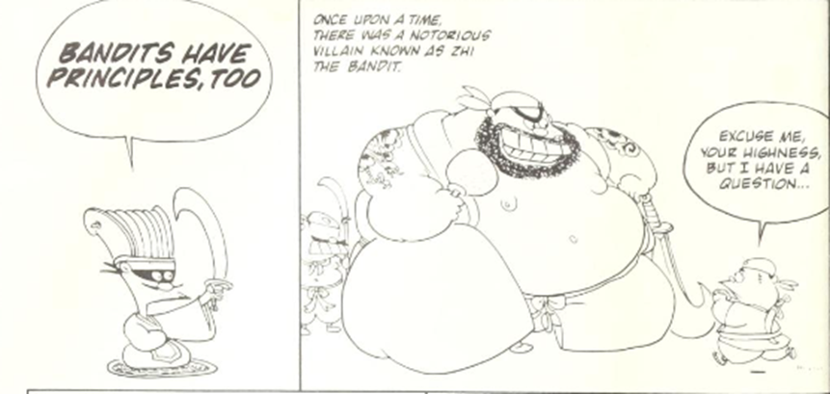
4.1 Image Analysis
4.1.1 Information Value
In the original (the colored picture), it can be seen that the story is expected to be read from right to left. In the translation, it can be seen that the image has been mirror flipped from the original.
Readers are asked to read the comics from left to right. In this case, the Given-New structure has also changed.
For social distance, Zhuangzi in the original right panel is shown in a medium close-up, emphasizing his detached yet instructive presence.
For power relations, Zhuangzi is depicted to be at eye level, giving him a sense of reason and neutrality and suggesting an equal status with the readers as well.

Slide 21
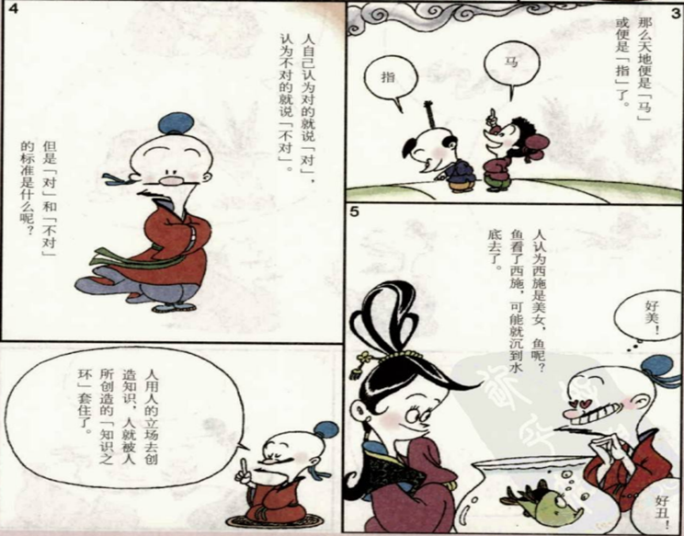
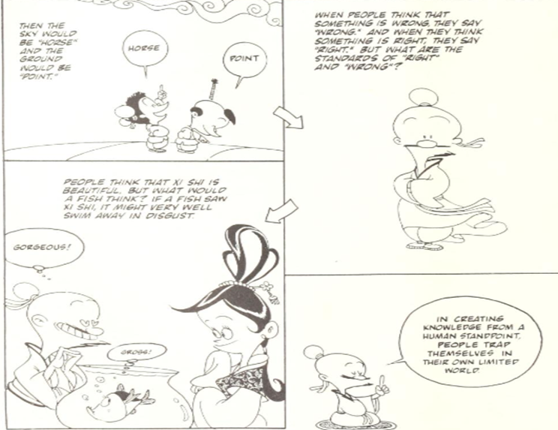
4.1.2 Framing
3.3 Analytical Framework
Framing is about the connection and disconnection of the composition realized through a variety of framing devices.
There are two types of framing: Segregation and Separation, depending on the degree to which an image is framed.

Slide 22
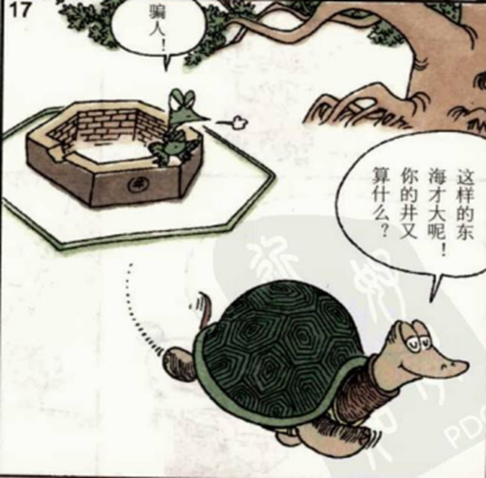
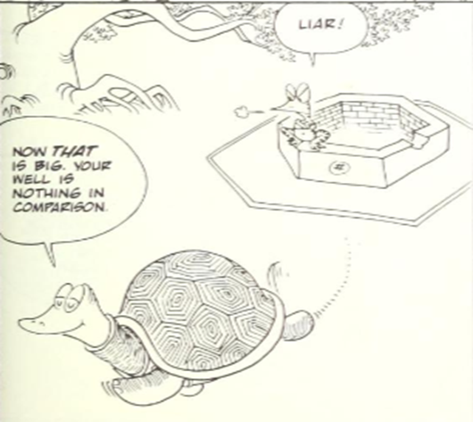
4.1.3 Salience
In the original image, the turtle seeks to emphasize the vastness of East Sea against the cramped well where the frog resides, saying “这样的东海才大呢！你的井又算得了什么？” Here, the first sentence in the utterance is made salient with an exclamation mark while the typography remains unchanged. By contrast, in the English version, the corresponding translated sentence “NOW THAT IS BIG.” has undergone dramatic typographical changes: the letters have been boldfaced and, in particular, the word “THAT” has been simultaneously boldfaced and italicized.

Slide 23
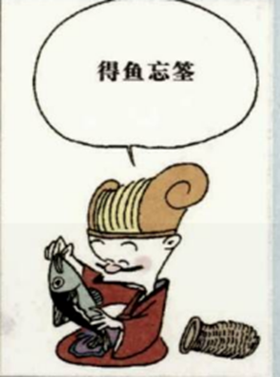
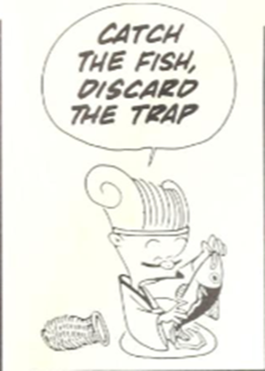
4.2 Image-Text Relations Analysis
 | Chinese (ST) | English (TT)
Image-Text Independent | Exposition | Exemplification
 | Exemplification | Exposition
 | Extension | Extension
 | Enhancement | Enhancement
Image-Text Complementary | Exemplification | Exemplification
 | Extension | Extension
 | Enhancement | Enhancement
Exposition Exemplification

Slide 24
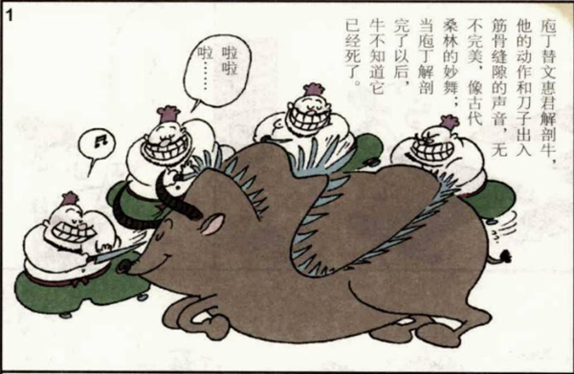
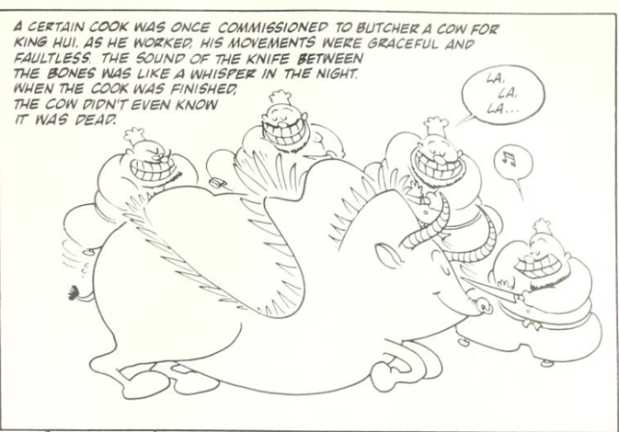
4.2 Image-Text Relations Analysis
A certain cook was once commissioned to butcher a cow for King Hui. As he worked, his movements were graceful and faultless. The sound of the knife between the bones was like a whisper in the night. The cow didn’t even know it was dead.
庖丁替文惠君解剖牛，他的动作和刀子出入筋骨缝隙的声音，无不完美，像古代桑林的妙舞；当庖丁解剖完了以后，牛不知道它已经死了。
Extension Extension

Slide 25
Part5
Comic Translation Strategy and Methods Based
on Multimodal Analysis

Slide 26
5.1 Translation Strategy
Drawing on the earlier discussion and supporting examples, it is reasonable to conclude that the translation, overall, is leaning towards domestication, or more specifically, localization.
Visually speaking, the translator should ensure the comic translation conforms to the reading habits and typography of the target country as opposed to blindly following the original.
As for the translation of verbal text, the translator is suggested to deploy pertinent and fitting expressions in the target language when translating culturally specific information to avoid overburdening target readers.

Slide 27
5.2 Translation Methods
Hyponym (Hypernym) Replacement
e.g. 原文：得鱼忘筌
译文：Catch the fish, discard the trap.
2. Explication
3. Addition:
addition of temporal phrases
addition of logical conjunctions

Slide 28
Part6
5.1 Major Findings
Conclusions
5.2 Implications
5.3 Limitations
5.4 Suggestions

Slide 29
6.1 Major Findings
Images in the translated version of Zhuangzi Speaks have indeed undergone visible changes. The reason has very much to do with visually different cultural conventions. Plus, investigation into the interactive function reveals that the way the visual image itself interacts with the viewer may also contribute to such a huge success.
Image-text relations in the translation do exhibit shifts. The disparity mostly stems from distinct knowledge background and visual literacy of the original and target readers. Even when the image-text relations in the translation are the same as those of the original, there are nuanced differences in how the verbal text modifies the image.
In terms of translation strategies, there is a heavy leaning towards domestication both on verbal and visual levels. As for specific translation methods, a characteristic one of comic translation may well be hyponymy replacement since the meaning in comics can always be better articulated via a combination of images and text than in other purely verbal forms.

Slide 30
6.2 Implications
1. By demonstrating the visual alterations and the changes in image-text relations involved in comic translation, the thesis emphasizes the importance of conducting multimodal analysis on a discourse that blends linguistic information with images during translation. Indeed, it identifies the need for translators to acquire visual literacy to address the intimate links between language and visuals.
2. It is found that visual grammar and image-text relations theory can go a long way in revealing the meaning of pictorial images and subtle interplay between two modes, making them suitable for future research on comic translation.
3. The thesis holds practical implications as it derives feasible translation strategies and methods specific to comics from the complimentary image-text relations, offering unique insight for Chinese-English comic translators.

Slide 31
6.3 Limitations
1. An inherent drawback in multimodal analysis, irrespective of analytical frameworks adopted, is that it depends mostly on observation, thus susceptible to personal judgement and bias. Plus, the thesis fails to identify the exact role the translator plays in altering the images. It could be the result from the press or discussions with the original author and the press.
2. The analysis entails a sole translation of the comic book as it is the only one available. The lack of comparison thus means it would be hard-pressed to examine the quality of the translation.
3. The translation strategies and methods derived from this study may only apply to similar Chinese comics saturated with culture-loaded content.

Slide 32
6.4 Suggestions for Future Studies
1. The framework of image-text relations could be further refined by prescribing how certain linguistic elements in Chinese correspond to what has been represented visually so as to reduce uncertainty and fuzziness. Besides, it would also be interesting to conduct an interview with the translator to determine his role in the visual changes seen in the comic.
2. Future research could take into account translation quality by comparing several translations of the same comic book and see how different treatment of image-text relations may affect the reception of certain translated work.
3. Future researchers should seek to extend the application of multimodal analysis to other domains in translation studies such as animation translation whose moving images may be distinct from the analysis of stills in comics

Slide 33
References
Barthes, Roland. 1977. Image-Music-Text [M]. New York: Macmillan.
Baldry, Anthony Peter, and Paul J. Thibault. 2006. Multimodal Transcription and Text Analysis: A Multimedia Toolkit and Coursebook [M]. Sheffield: Equinox.
Borodo, Michał. 2015. Multimodality, Translation and Comics [J]. Perspectives, 23(1): 22-41.
Celotti, Nadine. 2000. Méditer sur la Traduction des Bandes Dessinées: une Perspective de Sémiologie Parallèle [J]. Rivista Internazionale di Tecnica Della Traduzione, 5: 42-45.
Celotti, Nadine. 2008. The Translator of Comics as a Semiotic Investigator. In Federico Zanettin (ed.), Comics in Translation (pp. 33-39) [M]. New York: Routledge.
Delabastita, Dirk. 1989. Translation and Mass-communication: Film and TV Translation as Evidence of Cultural Dynamics [J]. Babel, 35(4): 193-218.
Forceville, Charles, and Eduardo Urios-Aparisi. 2009. Multimodal Metaphor [M]. Berlin: Mouton de Gruyter.
Grun, Maria, and Cay Dollerup. 2003. ‘Loss’ and ‘Gain’ in Comics [J]. Perspectives: Studies in Translatology, 11(3): 197-216.
Halliday, M. A. K., & Matthiessen, Christian. 1985. An Introduction to Functional Grammar [M]. London: Arnold.
Halliday, M. A. K., and Ruqaiya Hasan. 2014. Cohesion in English [M]. London: Routledge.
Harvey, Keith. 1998. Compensation. In Mona Baker (ed.), Encyclopaedia of Translation Studies (pp. 37–40) [M]. London: Routledge.
Huang, Guangzhe 2024. Reframing Zhuangzi through recontextualization: A multimodal analysis of front covers of both Zhuangzi Shuo and its three translations [J]. Babel, 70(1-2), 251-276.
Jewitt, Carey. 2009. The Routledge Handbook of Multimodal Analysis [M]. London: Routledge.
Kaindl, Klaus. 1999. Thump, Whizz, Poom: A Framework for the Study of Comics under Translation [J]. Target. International Journal of Translation Studies, 11(2): 263-288.

Slide 34
Kaindl, Klaus. 2004. Multimodality in the Translation of Humour in Comics [J]. Perspectives on Multimodality, 6: 173-209.
Kress, Gunther, and Theo van Leeuwen. 2001. The Modes and Media of Contemporary Communication [M]. London: Arnold.
Kress, Gunther., and Theo van Leeuwen. 2002. Colour as a Semiotic Mode: Notes for a Grammar of Colour [J]. Visual Communication, 1(3): 343-368.
Kress, Gunther. 2009. Multimodality: A Social Semiotic Approach to Contemporary Communication [M]. London: Routledge.
Kress, Gunther, and Theo van Leeuwen. 2020. Reading Images: The Grammar of Visual Design [M]. London: Routledge.
Ku, Pi-ling. 2000. Tsai Chih Chung: A New Lease of Life for the Chinese Classics [J]. International Institute for Asian Studies Newsletter, 6: 37.
Laili, Nuri Ma'rifatil. 2008. A Study of Onomatopoeia in Avatar Comics [D]. Universitas Islam Negeri Maulana Malik Ibrahim.
Martinec, Radan. 2000. Types of Processes in Action [J]. Semiotica, 130(3/4): 243-268.
Martinec, Radan, and Andrew Salway. 2005. A System for Image–Text Relations in New (and Old) Media [J]. Visual Communication, 4(3): 337-371.
O'toole, Michael. 1994. The Language of Displayed Art [M]. Vancouver: Fairleigh Dickinson University Press.
O’Halloran, Kay L. 2004. Multimodal Discourse Analysis: Systemic Functional Perspectives [M]. London: Continuum.
O'Halloran, Kay L. 2008. Mathematical Discourse: Language, Symbolism and Visual Images [M]. London: A&C Black.
Royce, Terry D. 2007. New Directions in the Analysis of Multimodal Discourse [M]. London: Routledge.
Zanettin, Federico. 2010. Humour in Translated Cartoons and Comics [J]. Translation, Humour and the Media, 2: 34-52.
Zanettin, Federico. 2015. Comics in Translation [M]. New York: Routledge.

Slide 35
陈静,刘云虹.漫画版《〈黄帝内经〉——养生图典》(汉英)与中医药典籍多模态翻译[J].北京第二外国语学院学报,2021,43(03):103-115.
胡壮麟.社会符号学研究中的多模态化[J].语言教学与研究,2007,(01):1-10.
冯德正, 张德禄, Kay O'Halloran. 多模态语篇分析的进展与前沿[J]. 当代语言学, 2014, 16(01): 88-99+126.
冯德正, 赵秀凤. 多模态转喻与图像语篇意义建构[J]. 外语学刊, 2017, (06): 8-13.
韩子满,黄广哲.典籍的“演译”：典籍漫画《庄子说》的人物多模态改写[J].外语研究,2023,40(01):81-86.
黄广哲,朱琳.以蔡志忠典籍漫画《孔子说》在美国的译介谈符际翻译[J].上海翻译,2018,(01):84-89+95.
梁萍,朱斌.中国传统文化典籍的多模态翻译探索——以蔡志忠《老子说》(中英文对照版)为例[J].菏泽学院学报,2023,45(01):137-142.
李战子.多模式话语的社会符号学分析[J].外语研究,2003,(05):1-8+80.
商祥艳. 多模态视角下的漫画翻译研究[D].中国石油大学(北京),2022.
孙毅.多模态话语意义建构——以2011西安世界园艺博览会会徽为基点[J].外语与外语教学,2012,(01):44-47.
王建开.经典与当代的融合:中国文学作品英译的通俗形态[J].当代外语研究,2014(10):49-54+78.
王振华,瞿桃.多模态语篇的评价研究:过去、现在与未来[J].外国语(上海外国语大学学报),2020,43(06):42-51.
杨向荣,黄培.2014.图像叙事中的语图互文——基于蔡志忠漫画艺术的图文关系探究[J].百家评论, (04):83-90.
杨纯芝,覃俐俐. 漫画翻译研究:回顾与前瞻[C]//四川西部文献编译研究中心.外语教育与翻译发展创新研究(第七卷）.四川师范大学电子出版社,2018:6.
喻旭东,陈琳.2019.儿童绘本突出语相翻译研究[J].成都师范学院学报,35(3):101-107.
朱永生.多模态话语分析的理论基础与研究方法[J].外语学刊,2007,(5):82-86.
张德禄.多模态话语分析综合理论框架探索[J].中国外语,2009,6(01):24-30.

Slide 36
.
张曼.浅析对外汉语教学的多模态模式[J].现代交际,2011,(11):217+216.
周宪.“读图时代”的图文“战争”[J].文学评论,2005,(06):140-148.
曾方本.多模态语篇里图文关系的解构及其模式研究——关于图文关系的三种理论评述[J].外国语文,2010,26(04):60-64.

Slide 37
.
谢谢聆听！

